Slide 1

Event Processing Course
Event processing of tomorrow (related to chapter 12)

Slide 2






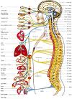
The grand challenge: Live Ecology
Asimov’s Gaia is a single living organism that consists of an entire planet
The Internet as a medium, with: Intelligent sensors actuators and processors can create such virtual living organism
The brain is distributed
Sensors can serve as eyes and ears, robots can serve as hands and feet
Event processing will serve as the nervous system (and maybe other biological systems)

Slide 3




Live Ecology – some examples:
Alert to a driver: the person crossing the street now is an Alzheimer patient who apparently lost his way
Decision on take-off and landing in the ash can be reduced to the individual aircraft (route, specific engine, RT ash density)

Slide 4
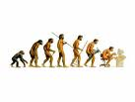

Getting there:
Evolution: through trends that are already occurring
Emerging directions: advances in the state-of-the-art

Slide 5

Evolution: Six trends to observe
Going from narrow to wide
Going from monolithic to diversified
Going from proprietary to standard-based
Going from programmer
centered to semi-technical developer
Going from stand-alone to embedded
Going from reactive to proactive

Slide 6
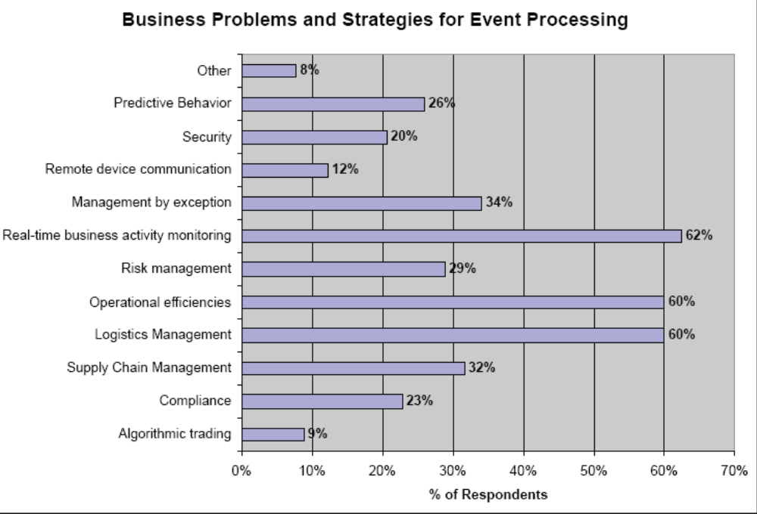
Trend I: Going from narrow to wide
Some recently reported applications (EPTS use-cases WG)
Border security radiation detection
Mobile asset geofence
Logistic and scheduling
Unauthorized use of heavy machinery
Hospital patient and asset tracking
Activity monitoring for taxing and fraud detection
Intelligent CRM in banking
EDA and asynchronous BPM in retail
Situation awareness in energy utilities
Situation awareness in airlines
Reduce cost in injection therapy
Next generation navigation
Real-time management of hazardous materials
Finding anomalies in point of sales in retail stores
Elderly behavior monitoring
Source: ebizQ Event processing market pulse

Slide 7
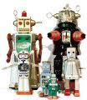

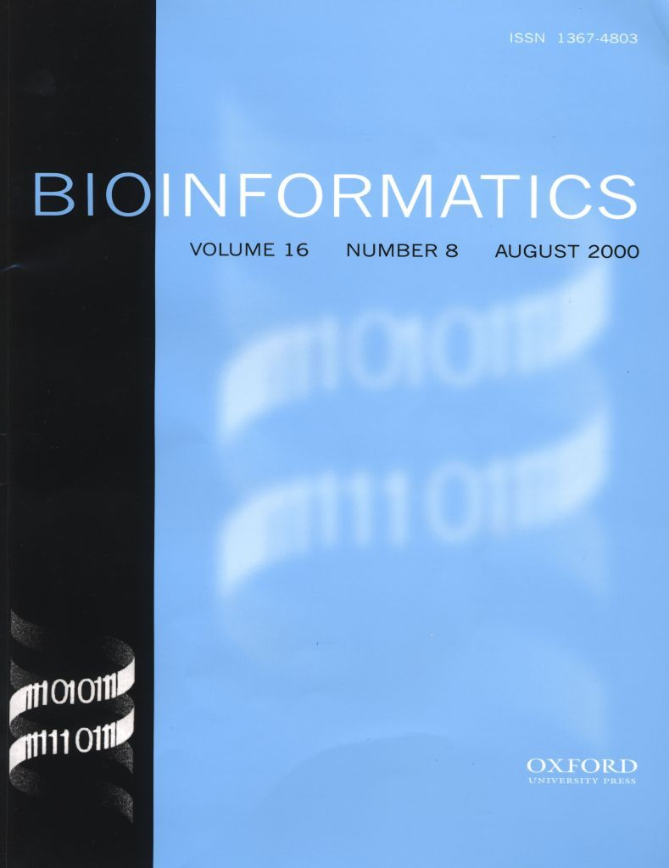
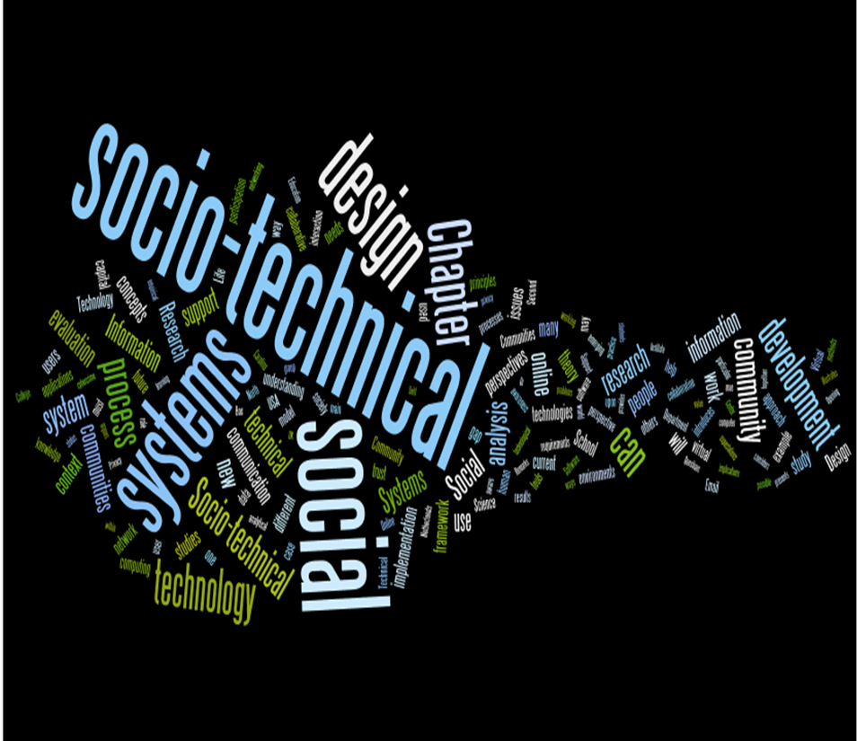
Trend I: Going from narrow to wide
Taking event processing outside enterprise computing:
Home
Automation
Robotics
Bio-Informatics
Socio-technical systems

Slide 8


Trend II: Going from monolithic to diversified
Variety of functions
Variety of Quality of Service requirements:
Variety of platforms
“One size fits all” will not work –
Instead a collection of building blocks
that can fit together

Slide 9


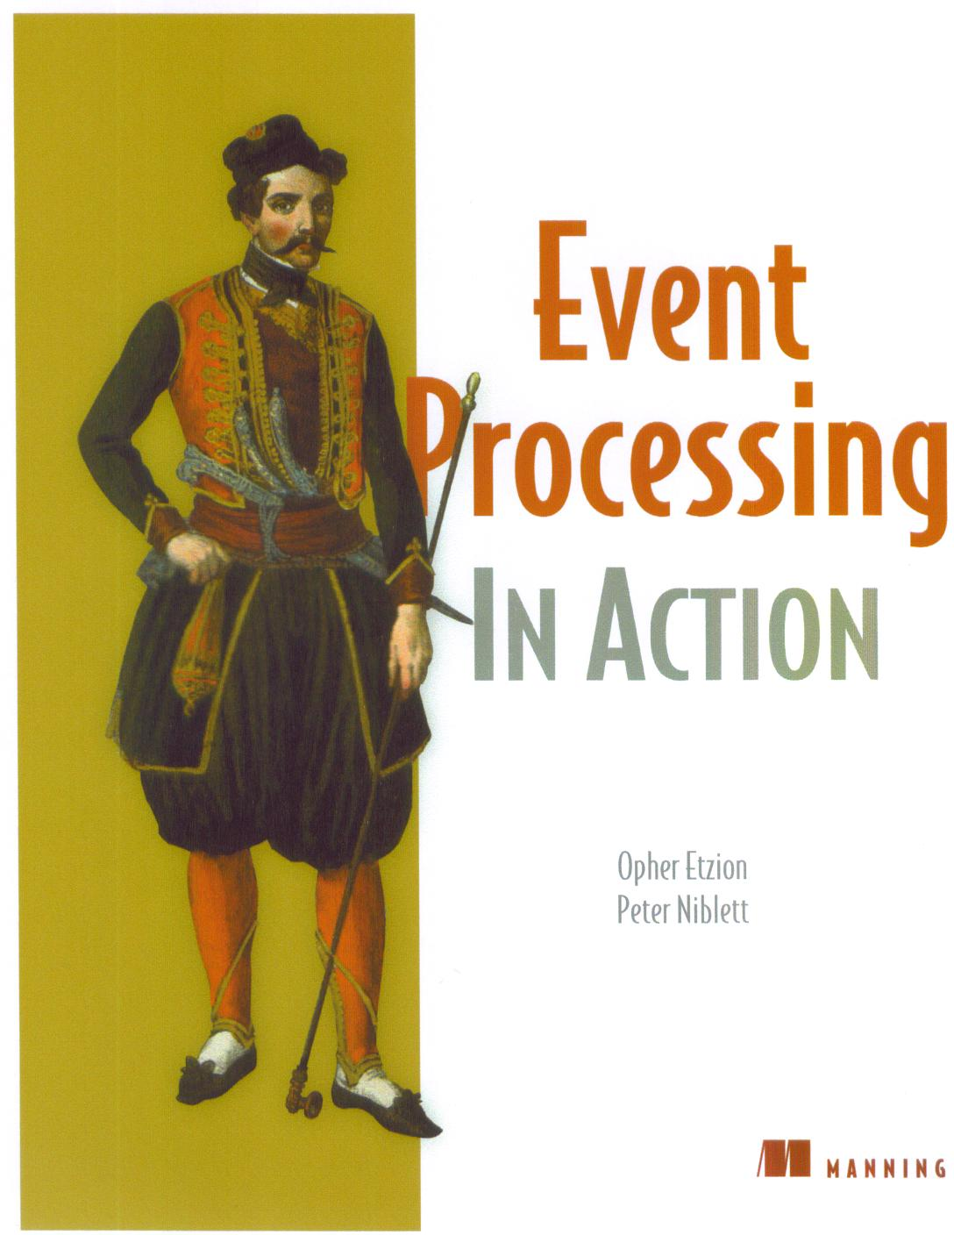

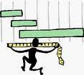
Trend III: Going from proprietary to standard-based – standard directions
The current situation: Babylon tower: variety of languages, event representation…
Serves as enabler to achieving other trends and general maturity
The shift of vendors from start-up dominant to bigger companies makes the atmosphere more friendly towards standards.
Areas for
Standards:
Modeling
Event representation
Interoperability
Languages
PIM

Slide 10
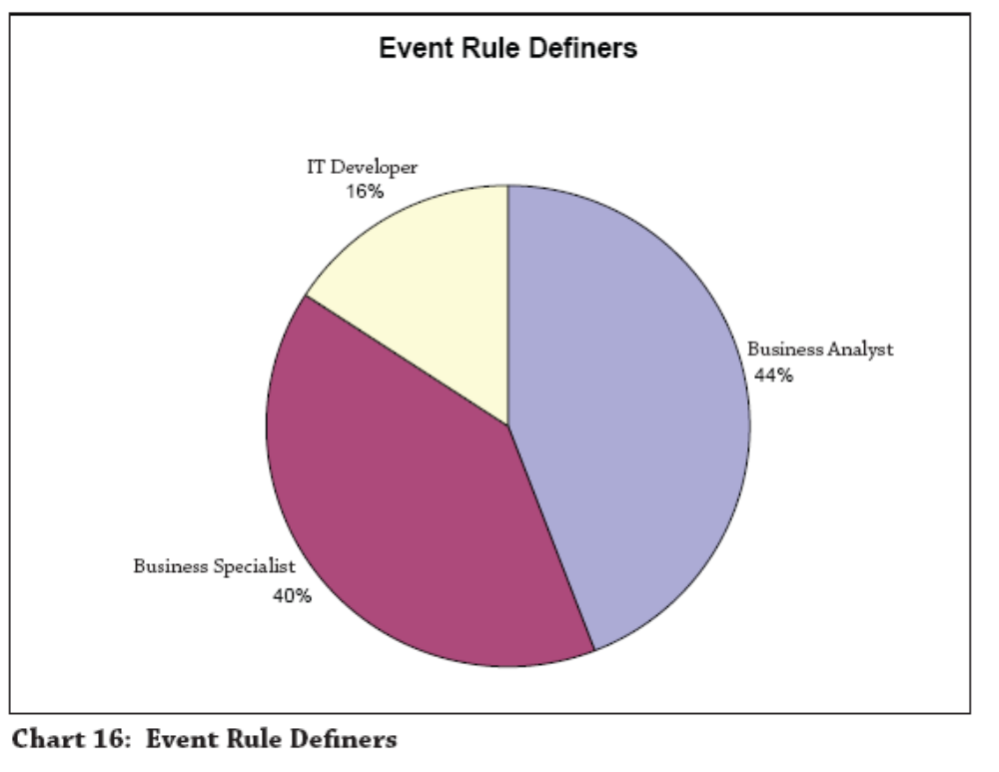
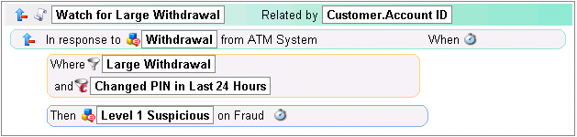
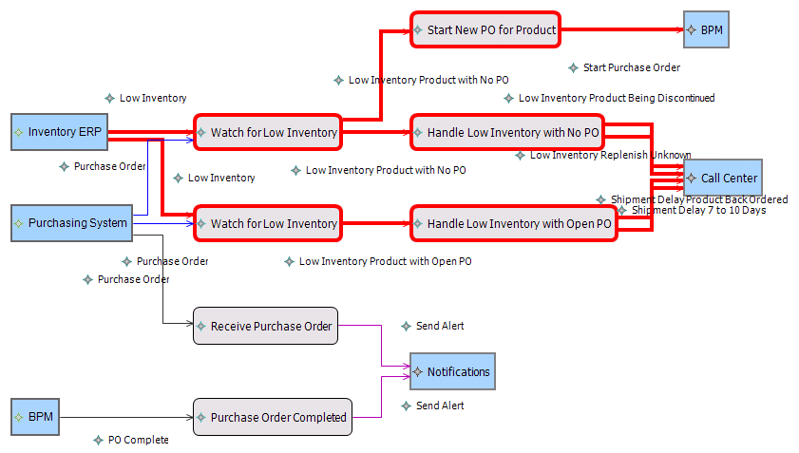
Trend IV: Going from programmer centered to semi-technical person centered
Source: ebizQ Event processing market pulse

Slide 11




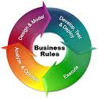


Trend V: Going from stand-alone to embedded
Packaged applications
Middleware and platforms
Business Activity Monitoring
Sensor Platform

Slide 12
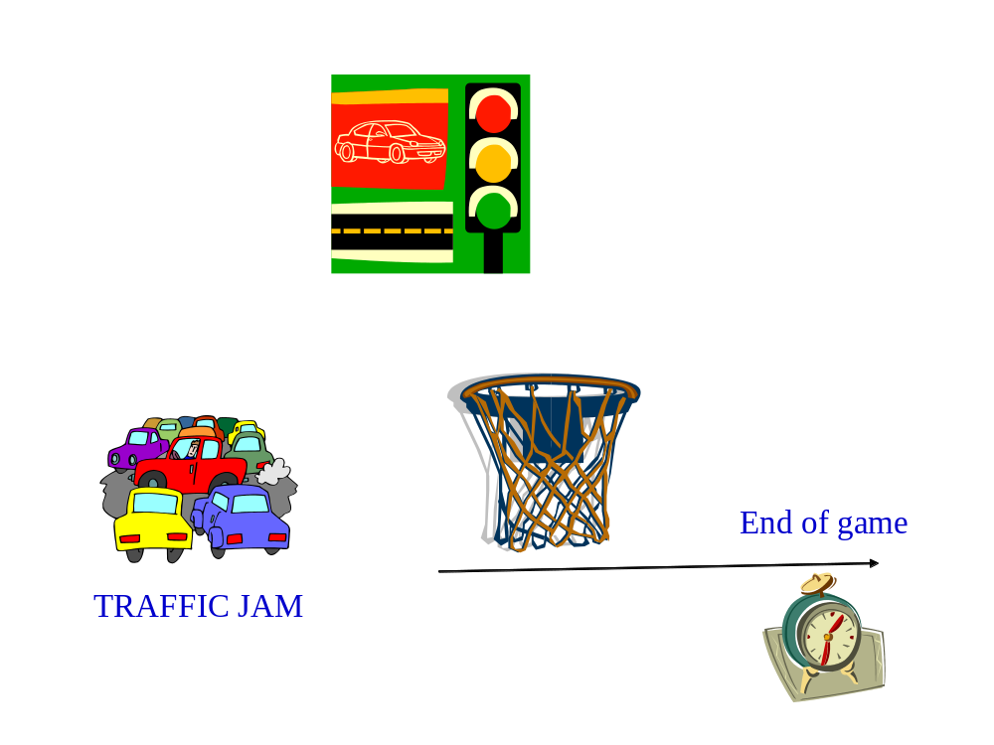
Trend VI: Going from reactive to proactive

Slide 13
Emerging directions: Four directions to observe
Multiple platforms – same look and feel
Tailor-made optimizations
The engineering of constructing EP applications
Adding intelligence to
Event processing

Slide 14
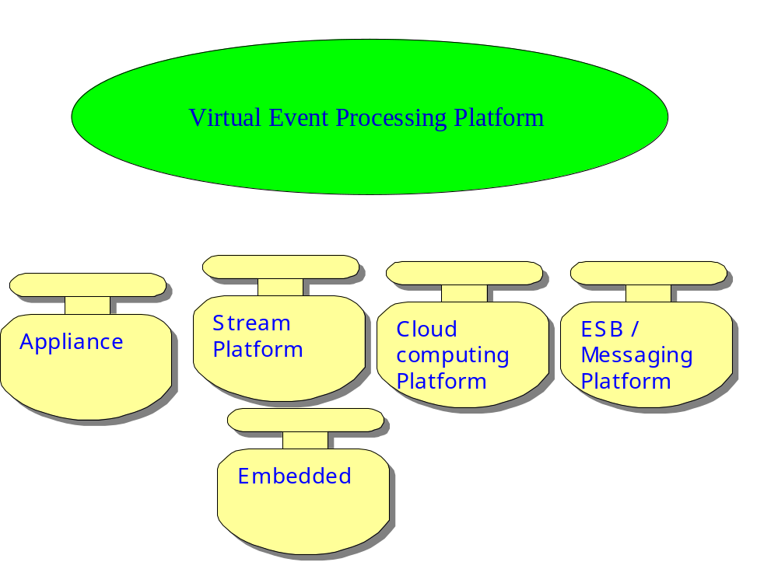
Emerging direction I: multiple platforms – same look and feel

Slide 15

Emerging direction II: Tailor-made optimizations
Local optimizations: each EPA will be optimized for its own purpose / assumptions / QoS indicators – average/worst case latency, input/output throughput …
Global optimization: scheduling, load balancing, assignment…
Global optimizations
Producer
EPA
EPA
Consumer
EPA
Producer
EPA
EPA
Consumer
Local optimizations

Slide 16

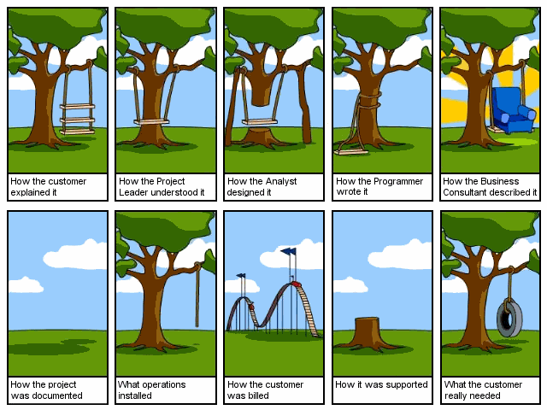

Emerging direction III:
Event processing software engineering
Modeling
& meta-modeling
Methodologies
Design
Patterns
Best practices

Slide 17


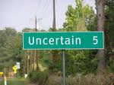
Emerging direction IV:
Intelligent event processing
Offline and continuous mining of meaningful patterns in event histories
Inexact event processing – handling inexact events and also false positives and false negatives
Causality – a key for proactive, but also vital for provenance

Slide 18
Summary
Event processing will be the “nervous system” of future human ecology.
It is already been used in certain domains, but barely scratched the surface.
Six trends and four directions have been presented

